Slide 1

Railway Reservation System using Queue
CSA 0315 – Data Structures
Presented by:
P. Mahitha(192524136)
R. Usha(192525100)
K. Madhulika(192524190)
Supervisior:
Dr. T. Rajesh Kumar

Slide 2


Aim
To develop a Railway Reservation System using the Queue data structure.
To manage passenger ticket bookings efficiently.
To maintain the waiting list using the First-In, First-Out (FIFO) principle.
To automatically allocate vacant seats to waiting-list passengers after ticket cancellations.
. To demonstrate the practical application of queues in solving real-world railway reservation problems.

Slide 3
Abstract
The Railway Reservation System is used to manage train ticket bookings.
A Queue is used to maintain the waiting list of passengers.
If seats are available, passengers receive confirmed tickets.
If seats are full, passengers are added to the waiting queue.
When a ticket is cancelled, the first passenger in the waiting queue gets the available seat.
The system ensures fair, efficient, and organized reservation management

Slide 4
Introduction
Railway reservation systems help passengers book train tickets and manage reservations efficiently.
During peak seasons, when seats are full, additional passengers are placed on a waiting list.
The Queue data structure follows the FIFO (First-In, First-Out) principle, making it suitable for waiting list management.
When a confirmed ticket is cancelled, the first passenger in the waiting queue is given the available seat.

Slide 5
Module 1 :Ticket Booking & Booking Queue
Passenger enters booking details.
System validates the entered information.
Booking request is added to the Booking Queue.
Requests are processed one by one in FIFO order.
Valid requests are forwarded to the Seat Allocation Module.

Slide 6
Module 2 : Priority-Based Seat Allocation
Receive booking request from the Booking Queue.
Check seat availability.
Verify passenger priority.
Allocate an available seat.
If no seat is available, move the passenger to the Waiting List.

Slide 7
Module 3 : Waiting List & Cancellation Manager
Passenger is added to the Waiting List if no seat is available.
Waiting List follows the FIFO order.
A confirmed passenger cancels the ticket.
The system releases the vacant seat.
The first passenger in the Waiting List receives the confirmed seat.
The Waiting List is updated automatically

Slide 8
Algorithm
Start the reservation process.
Enter passenger details and add the request to the booking queue.
Check seat availability.
Allocate seats based on passenger priority if seats are available.
Add passengers to the waiting queue if no seats are available.
Process cancellations and assign released seats to the first passenger in the waiting queue (FIFO).
Update booking records and display the final ticket status.
End the process.

Slide 9
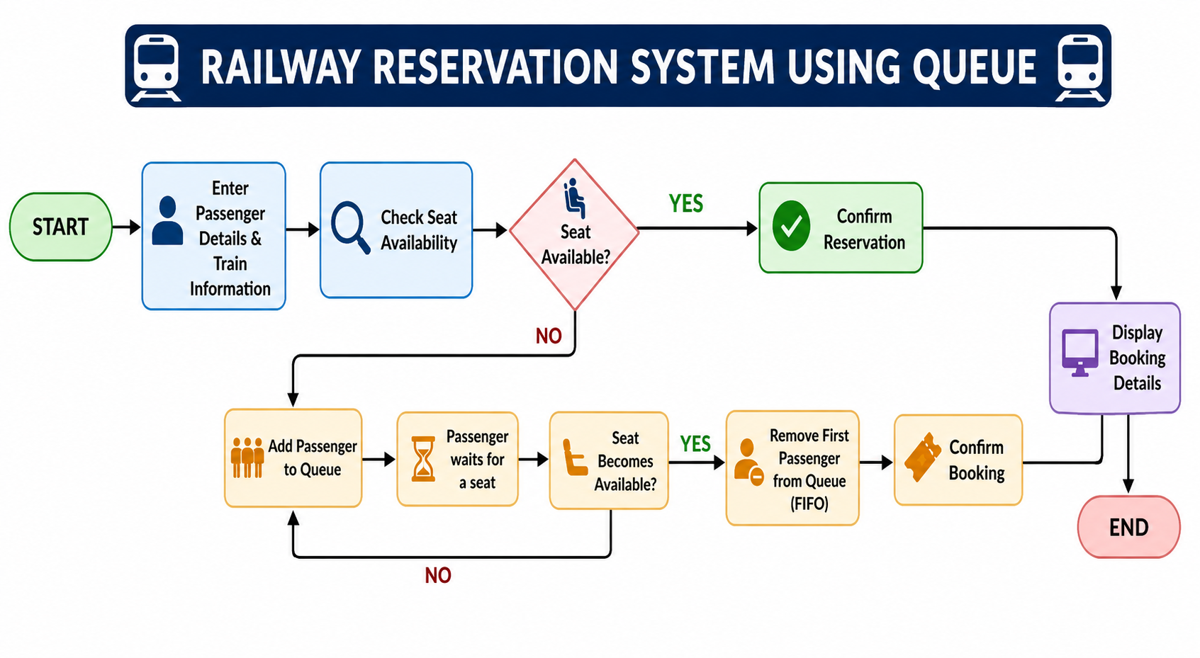
Flow Chart

Slide 10
Results and Discussions
Successfully implemented a Railway Reservation System using Queue.
The FIFO principle ensures passengers are processed in their reservation order.
Enqueue and Dequeue operations efficiently manage passenger reservations.
Waiting-list passengers are maintained systematically when seats are unavailable.
The system provides simple, fair, and efficient reservation management.

Slide 11
Conclusion
The Railway Reservation System using Queue provides a simple and efficient solution for managing ticket reservations.
The FIFO (First In, First Out) queue ensures that booking requests are processed fairly.
The system automatically manages ticket booking, seat allocation, waiting lists, and cancellations.
It reduces manual effort, improves reservation accuracy, and speeds up ticket processing.
Overall, the project offers a reliable, transparent, and user-friendly railway reservation system.

Slide 12
References
Qasim, S. M., & Farooquie, J. A. (2024). “Economics of Secondary Queue of Indian Railways Passenger Reservation System: A Queueing Science Approach.” OPSEARCH, 61(4), 1795–1824.
Xu, J., Deng, L., Hu, X., Tan, J., & Tan, W. (2024). “Joint Optimization of Overbooking and Seat Allocation for High-Speed Railways Considering Stochastic Demand.” PLOS ONE.
Bešinović, N., García-Ródenas, R., López-García, M. L., et al. (2024). “The Time Slot Allocation Problem in Liberalised Passenger Railway Markets: A Multi-Objective Approach.”
Cardonha, C. H., & Raghunathan, A. U. (2024). “Coach Reservation for Group Requests.”
“Seat Allocation Optimization for Railway Systems with Equity Considerations.” (2025). Transportmetrica B: Transport Dynamics

Slide 13


